Slide 1
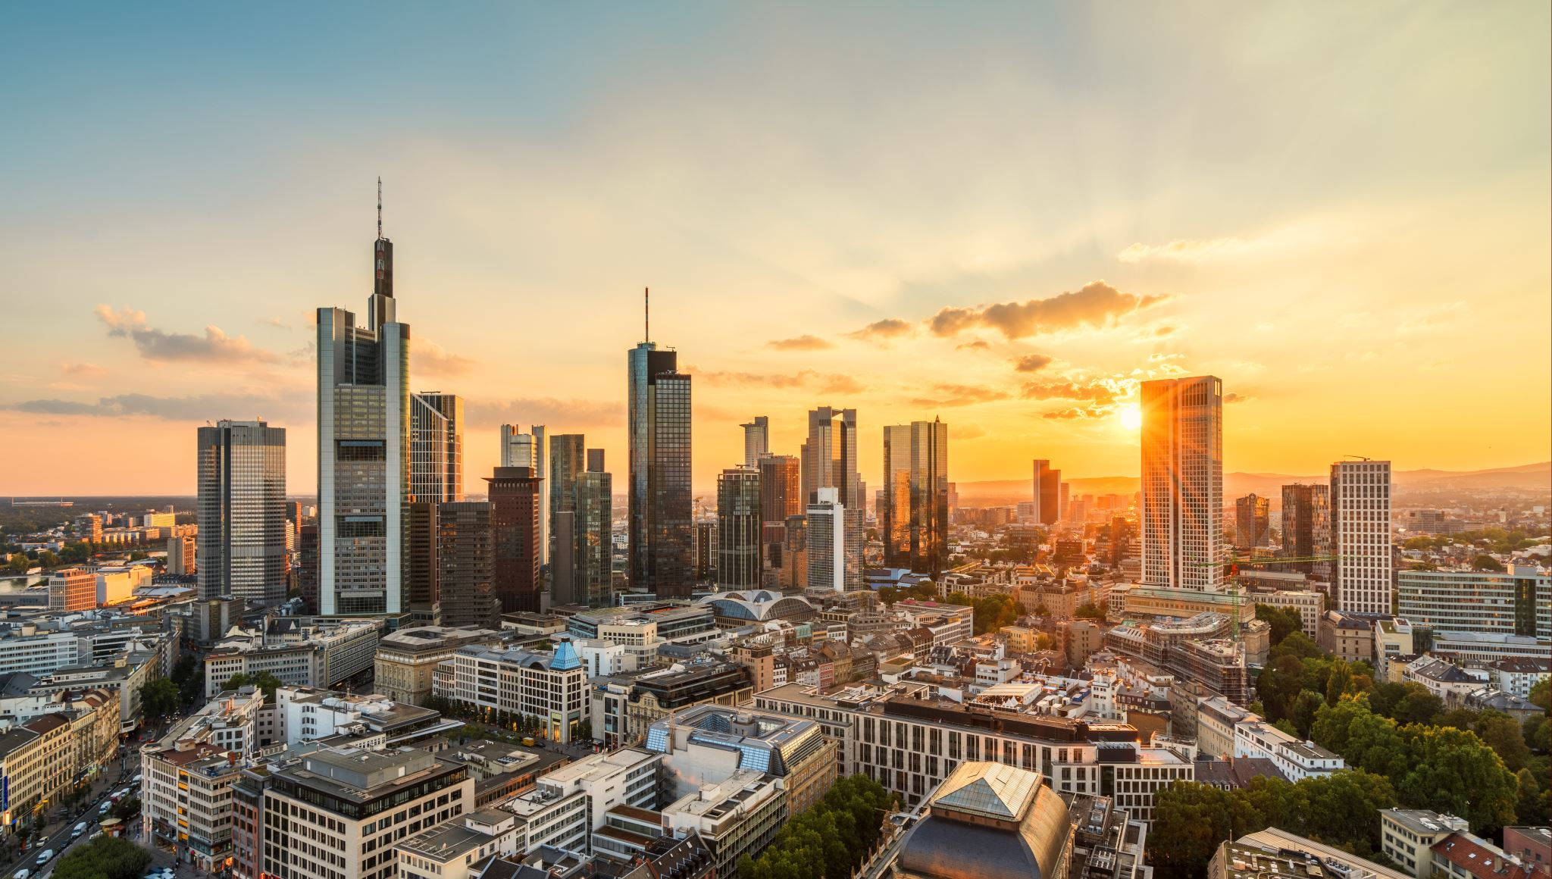
CLUSTERING RESULTS
VANCOUVER AND TORONTO NEIGHBORHOOD COMPARISONS

Slide 2
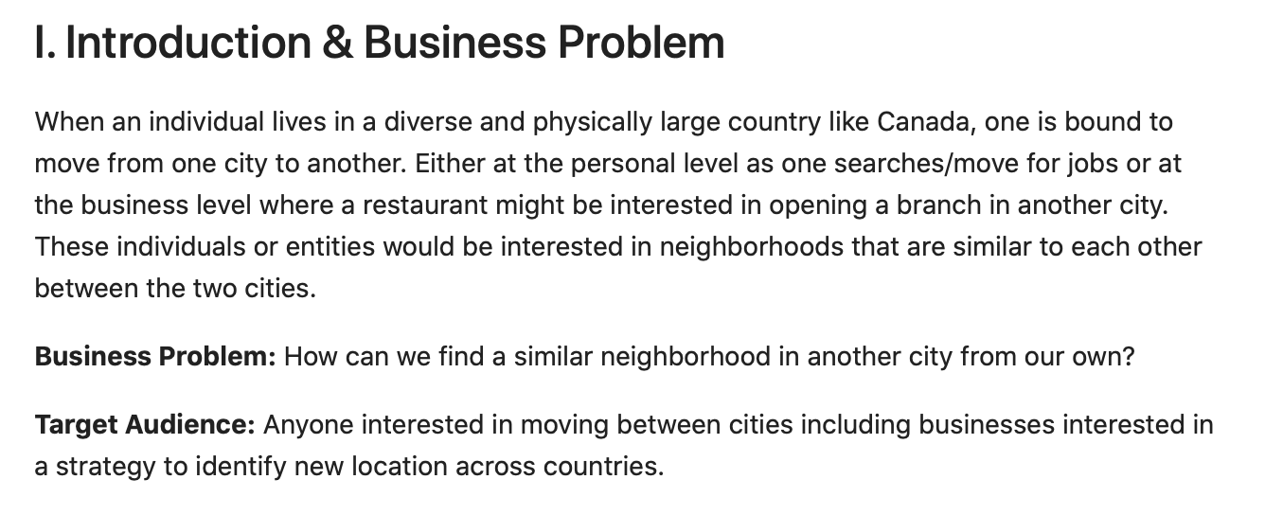

Slide 3
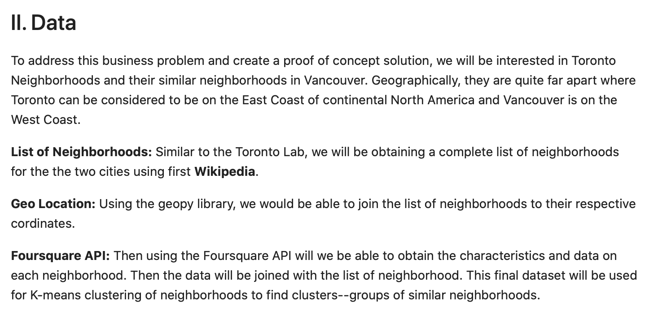

Slide 4
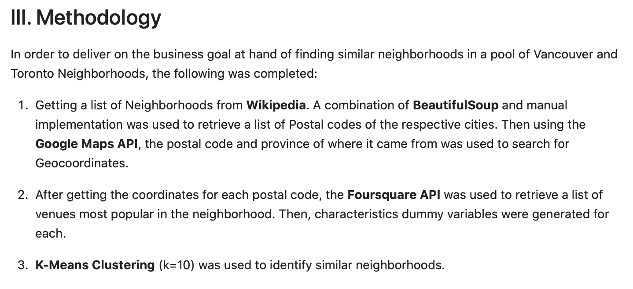

Slide 5
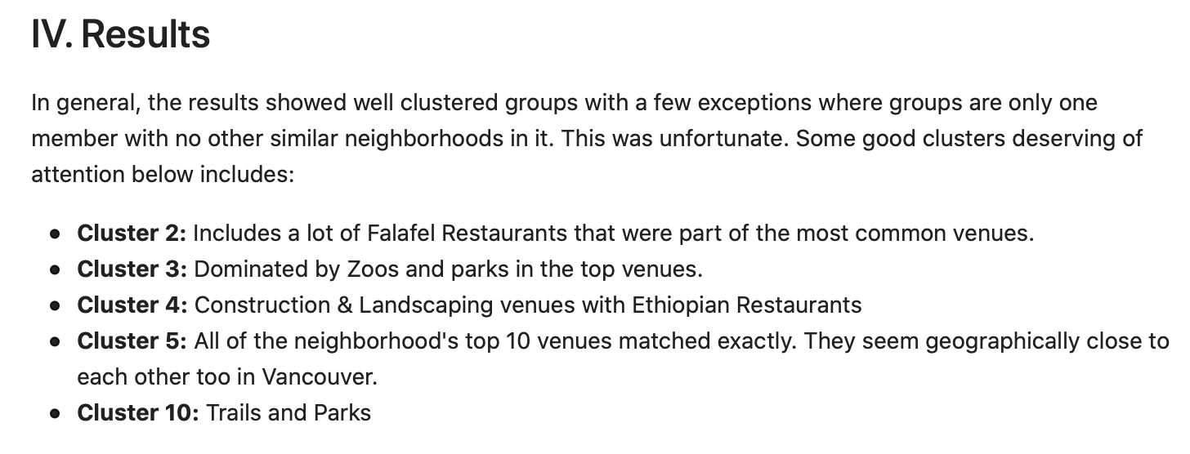

Slide 6
CLUSTER 2

Slide 7
CLUSTER 3

Slide 8
CLUSTER 4

Slide 9
CLUSTER 5

Slide 10
CLUSTER 10

Slide 11
